Slide 1


Lab 8
Tensor Manipulation
With TF 1.0!
Sung Kim <hunkim+ml@gmail.com>
Code: https://github.com/hunkim/DeepLearningZeroToAll/

Slide 2

Call for comments
Please feel free to add comments directly on these slides
Other slides: https://goo.gl/jPtWNt
Picture from http://www.tssablog.org/archives/3280

Slide 3
Lab 8
Tensor Manipulation
With TF 1.0!
Sung Kim <hunkim+ml@gmail.com>
Code: https://github.com/hunkim/DeepLearningZeroToAll/

Slide 4
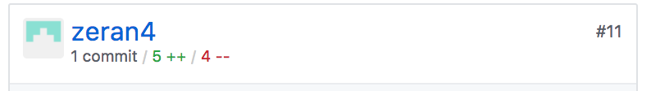
https://github.com/hunkim/DeepLearningZeroToAll/

Slide 5
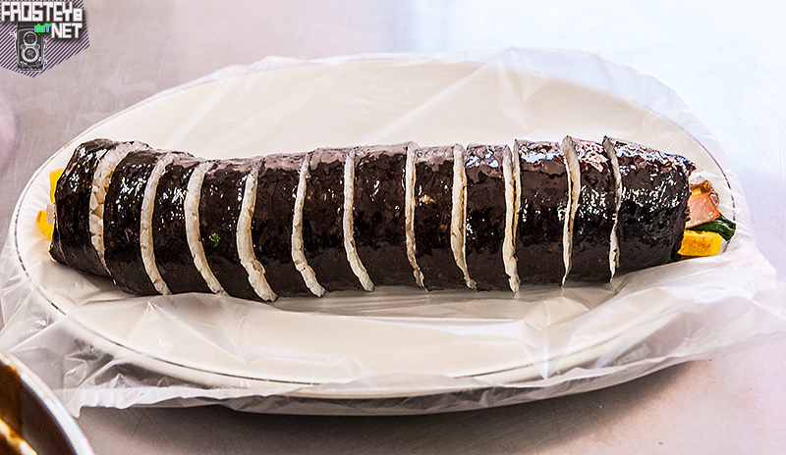
Simple 1D array and slicing
t = np.array([0., 1., 2., 3., 4., 5., 6.])
Image from http://www.frosteye.net/1233

Slide 6
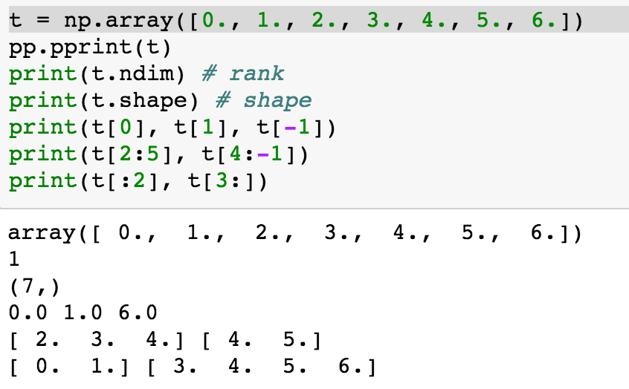
Simple 1D array and slicing
Image from http://www.frosteye.net/1233

Slide 7
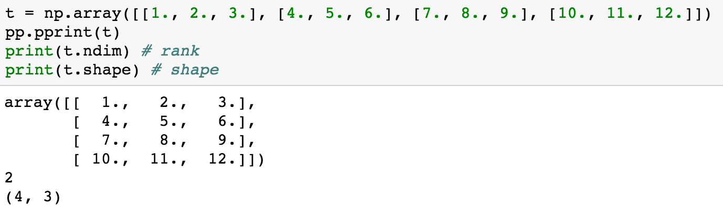
2D Array
https://github.com/hunkim/DeepLearningZeroToAll/blob/master/lab-08-tensor_manipulation.ipynb

Slide 8
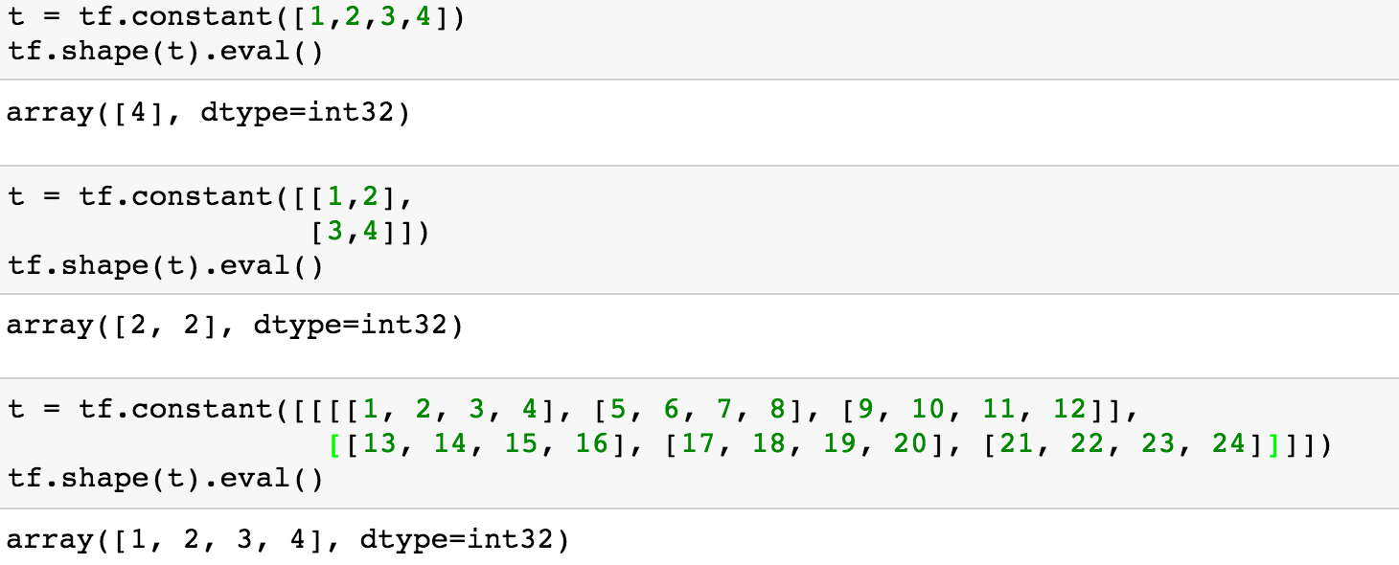
Shape, Rank, Axis
https://github.com/hunkim/DeepLearningZeroToAll/blob/master/lab-08-tensor_manipulation.ipynb

Slide 9
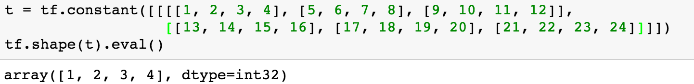
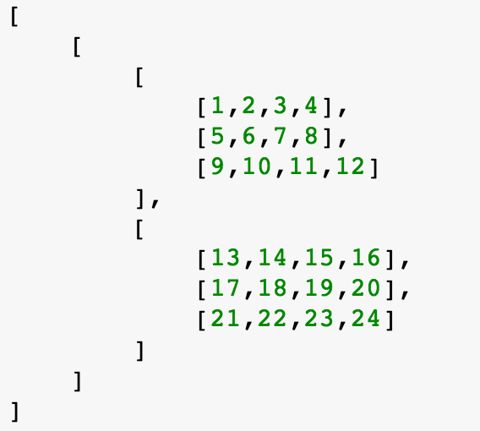
Shape, Rank, Axis
https://github.com/hunkim/DeepLearningZeroToAll/blob/master/lab-08-tensor_manipulation.ipynb

Slide 10
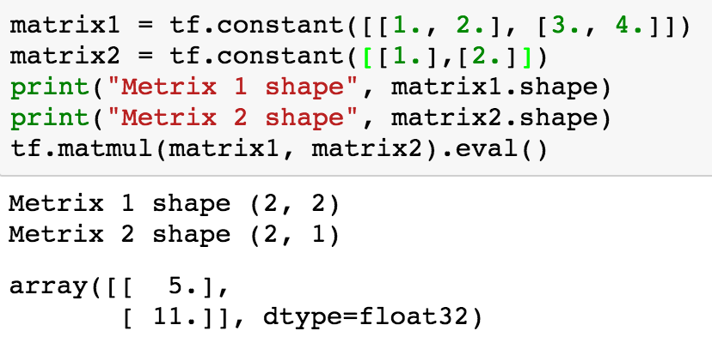
Matmul VS multiply
https://github.com/hunkim/DeepLearningZeroToAll/blob/master/lab-08-tensor_manipulation.ipynb

Slide 11
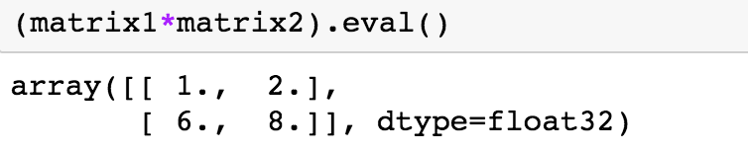
Matmul VS multiply
https://github.com/hunkim/DeepLearningZeroToAll/blob/master/lab-08-tensor_manipulation.ipynb

Slide 12

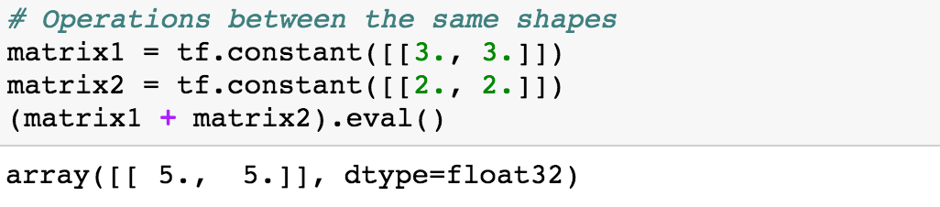
Broadcasting
https://docs.scipy.org/doc/numpy/user/basics.broadcasting.html

Slide 13
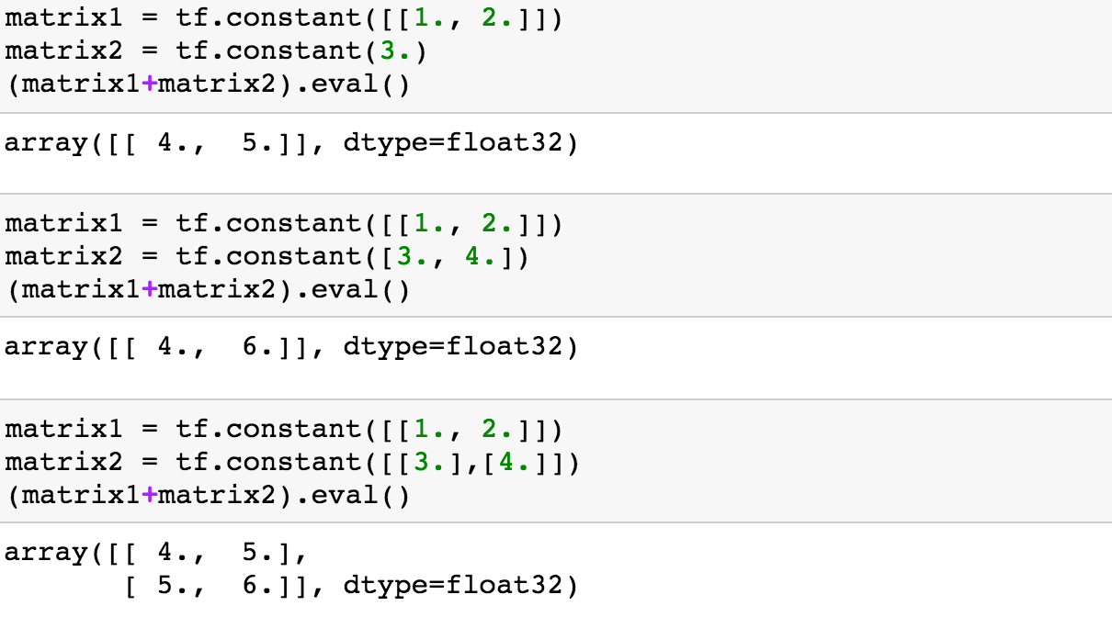
Broadcasting
https://docs.scipy.org/doc/numpy/user/basics.broadcasting.html

Slide 14
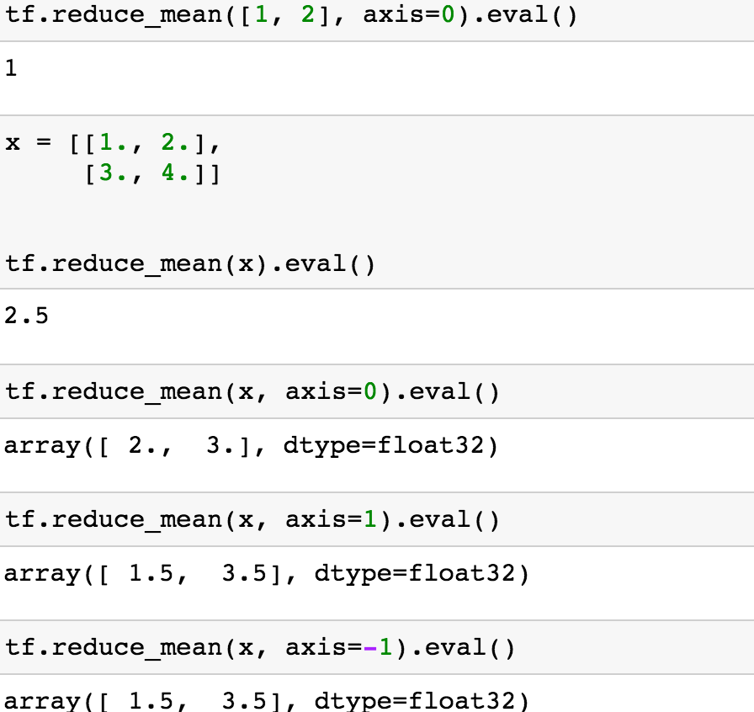
Reduce mean
https://github.com/hunkim/DeepLearningZeroToAll/blob/master/lab-08-tensor_manipulation.ipynb

Slide 15
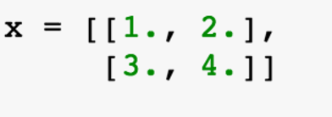
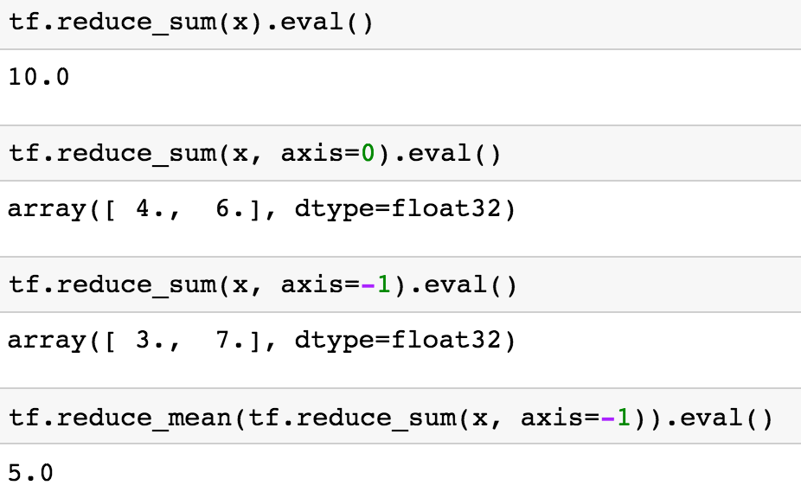
Reduce sum
https://github.com/hunkim/DeepLearningZeroToAll/blob/master/lab-08-tensor_manipulation.ipynb

Slide 16
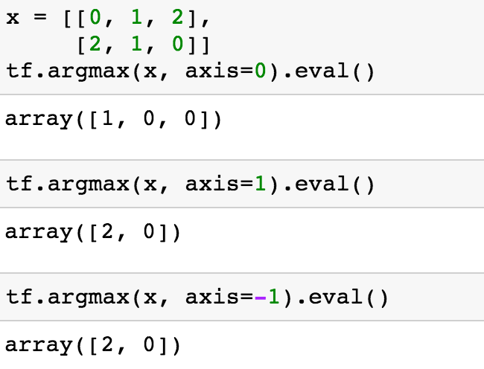
Argmax
https://github.com/hunkim/DeepLearningZeroToAll/blob/master/lab-08-tensor_manipulation.ipynb

Slide 17
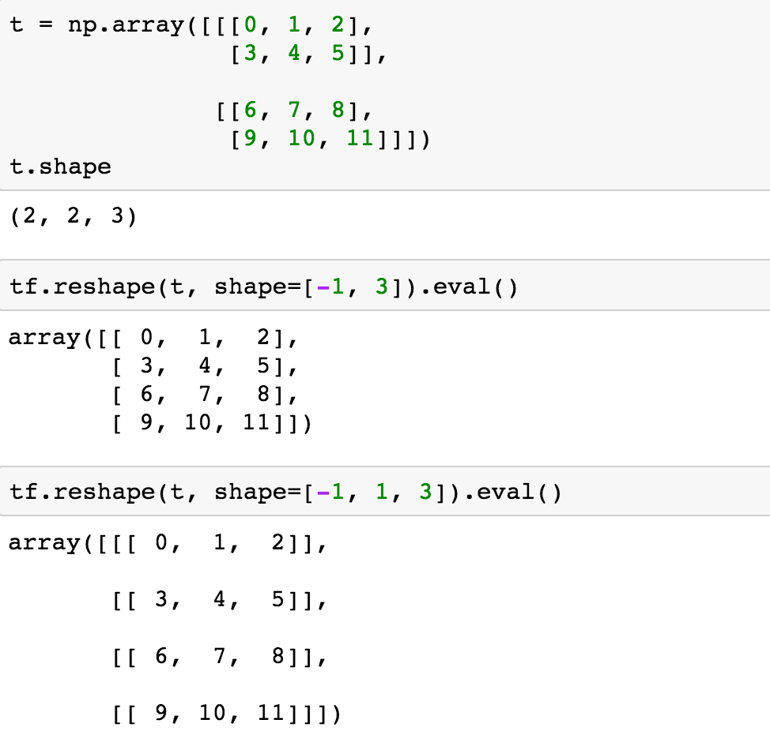
Reshape**
https://github.com/hunkim/DeepLearningZeroToAll/blob/master/lab-08-tensor_manipulation.ipynb

Slide 18
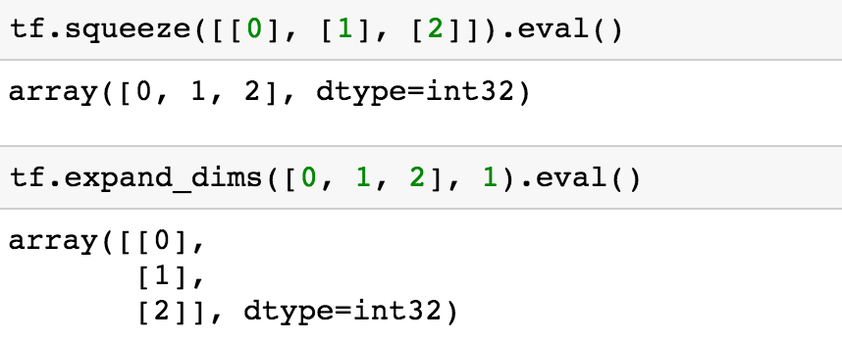
Reshape (squeeze, expand)
https://github.com/hunkim/DeepLearningZeroToAll/blob/master/lab-08-tensor_manipulation.ipynb

Slide 19
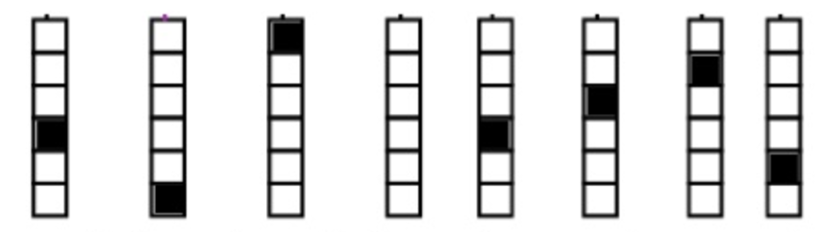
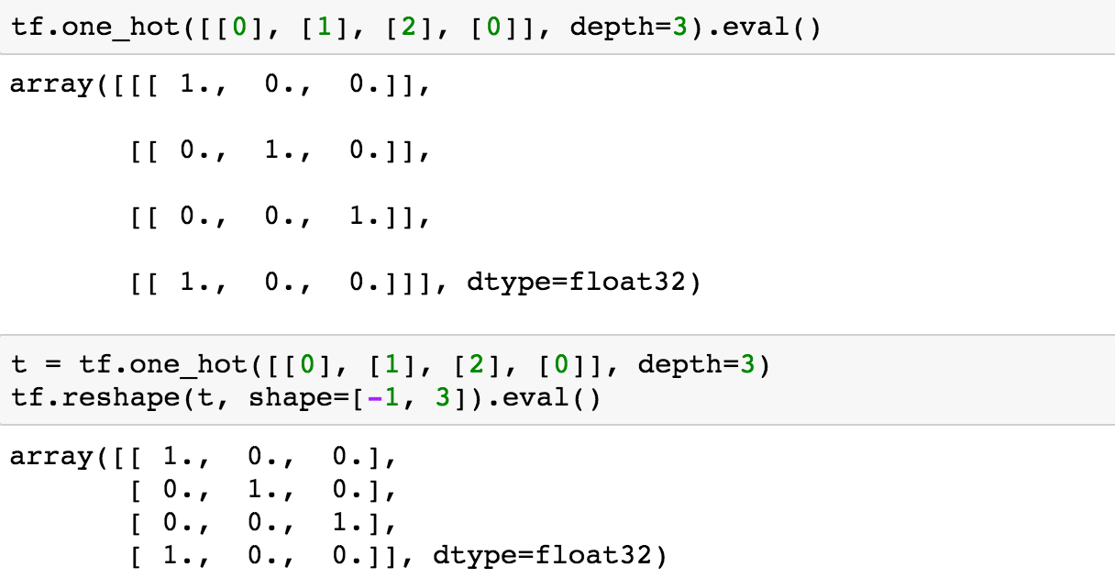
One hot
https://github.com/hunkim/DeepLearningZeroToAll/blob/master/lab-08-tensor_manipulation.ipynb

Slide 20
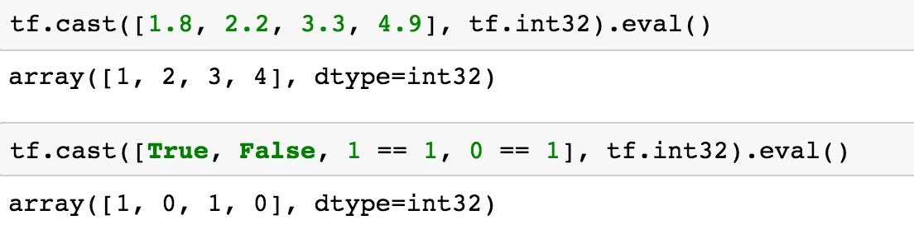
Casting
https://github.com/hunkim/DeepLearningZeroToAll/blob/master/lab-08-tensor_manipulation.ipynb

Slide 21
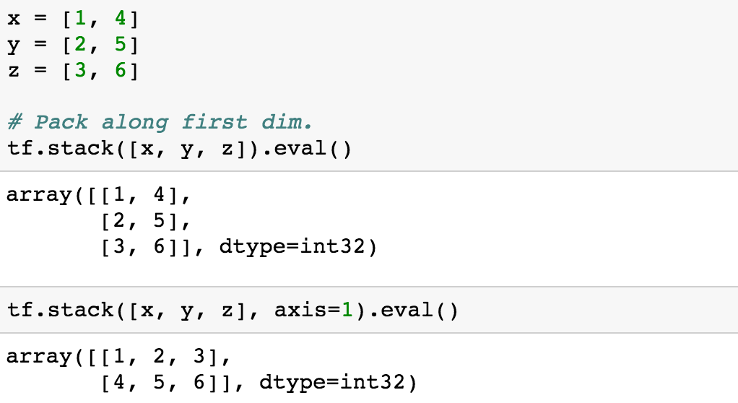
Stack
https://github.com/hunkim/DeepLearningZeroToAll/blob/master/lab-08-tensor_manipulation.ipynb

Slide 22
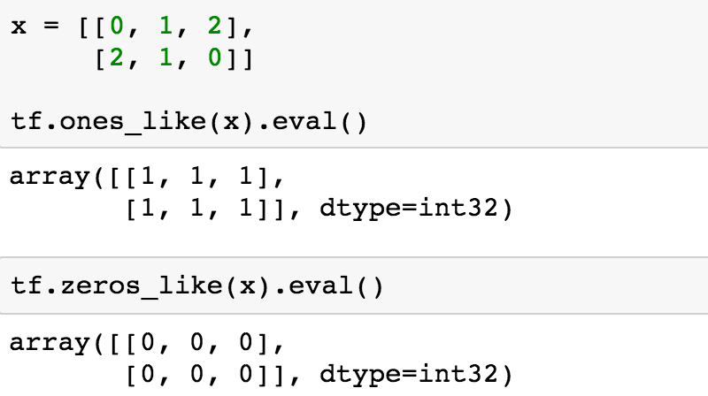
Ones and Zeros like
https://github.com/hunkim/DeepLearningZeroToAll/blob/master/lab-08-tensor_manipulation.ipynb

Slide 23

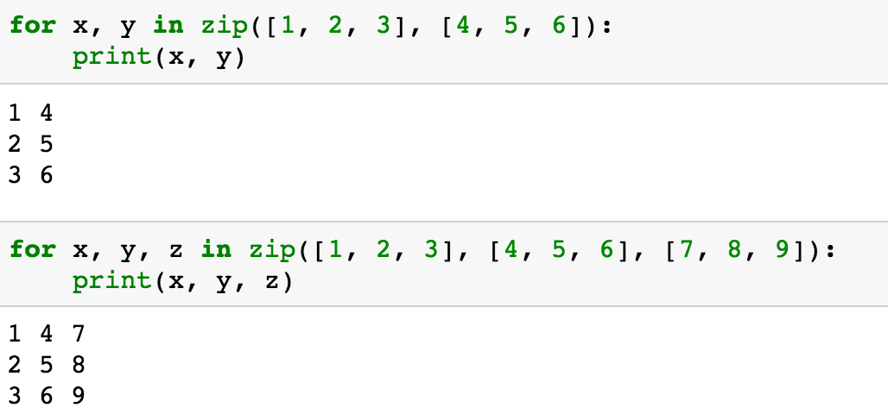
Zip
https://github.com/hunkim/DeepLearningZeroToAll/blob/master/lab-08-tensor_manipulation.ipynb

Slide 24


Slide 25
Lab 9-1
NN for XOR
With TF 1.0!
Sung Kim <hunkim+ml@gmail.com>
Code: https://github.com/hunkim/DeepLearningZeroToAll/

